Slide 1
Disposit
INFM 600 Team 3
Angela Tseng
Iskander Lou
Jasper Evans
Sharvil Shastri
Abdul Shaik
Dhiraj Lahoti
Notes:
what the service is, what information is needed, how information is collected, processed, analyzed, and stored, and the expected utilities and/or impacts of the service
unifying vision for the service, how the service is embedded in the environment where it is used, and the features and functions of the service (data, process, interface, etc.)

Slide 2
The Problem
⦿ Over 50 million tons of E-waste produced annually.
⦿ Only 20% recycled
⦿ E-waste recycling has not been normalized in society.
Notes:
Information regarding e-waste and how to recycle it is confusing and difficult to access
for the average person. The difference in policy between municipalities, or lack of policy at all,
makes it confusing for people to figure out the recycling procedure that applies to them. If there
was a convenient, easy to understand way for users to look up how to recycle e-waste in their
area, people would be far more inclined to participate in electronics recycling. Consequently,
higher participation in electronics recycling would drastically cut down on the amount of e-waste
sent to landfills annually, putting it on par with that of municipal solid waste.

Slide 3
The Solution
Unifying Website
Location
Options
Quickly and accurately inform citizens of their options when it comes to recycling their electronic devices
Viewing e-waste recycling options in their area in the form of a website
Form a list of all e-waste recycling options that apply to them
Notes:
Our solution aims to educate users by providing a simple, convenient method for viewing
e-waste recycling options in their area in the form of a website. This website will quickly and
accurately inform citizens of their options when it comes to recycling their electronic devices.
Once a user accesses the site, it will determine their location, form a list of all e-waste recycling
options that apply to them, and present the list to them in a user-friendly manner.
Consolidating all of the information into one page greatly reduces the
current confusion with figuring out how to recycle in one’s city.

Slide 4
Information Needed
01
Laws and policies on e-waste
02
Recycling Center Location Data
03
Description Repository of Various Types of Electronics and Batteries
04
Connection to Aggregated news - related to Recycling

Slide 5
Utilities
Impacts of the Service
Find Nearby E-Waste Recycling Centers
Find Recycling Instructions by Item Type
Deliver Timely News to Users related to E-Waste Initiatives.
Provide Users with Educational information related to the recycling process and its impacts.
Normalizing the Practice of recycling E-waste.
Reducing the environmental exposure to harmful substances.
Reducing the need for manufacturing pollution.
Conserves energy that would otherwise be used for natural resource mining.

Slide 6
How Information Is…
01
02
Collected
Processed
03
04
Analyzed
Stored

Slide 7
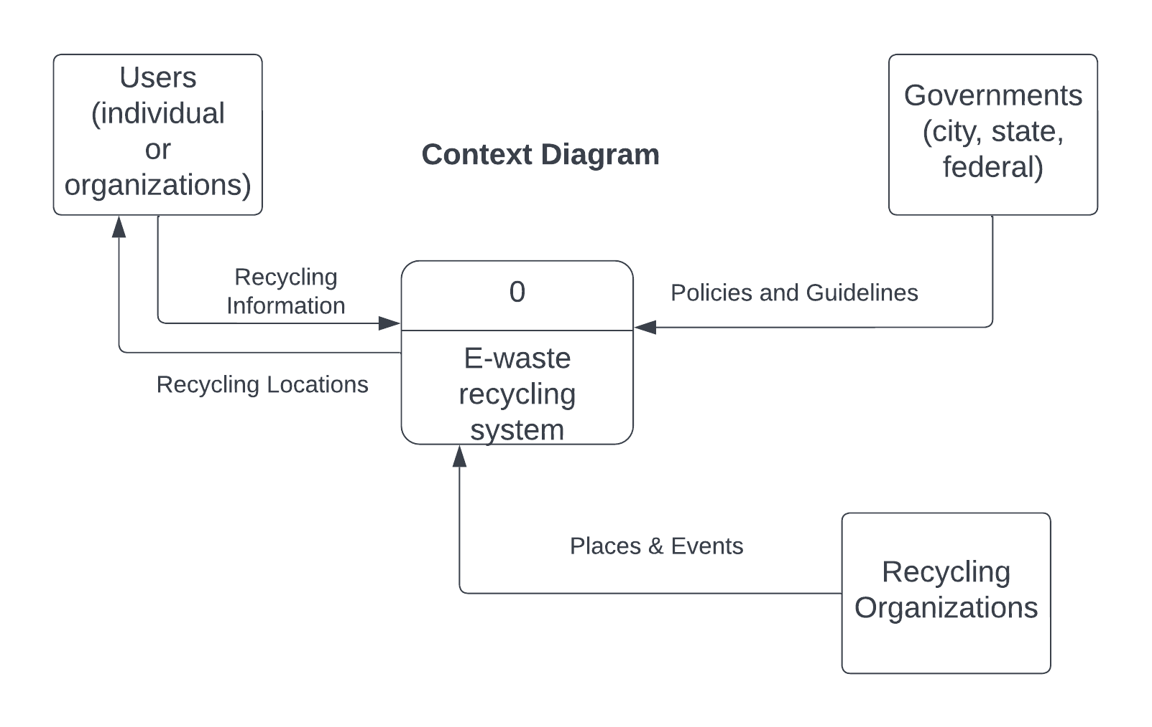
DFD Diagram

Slide 8
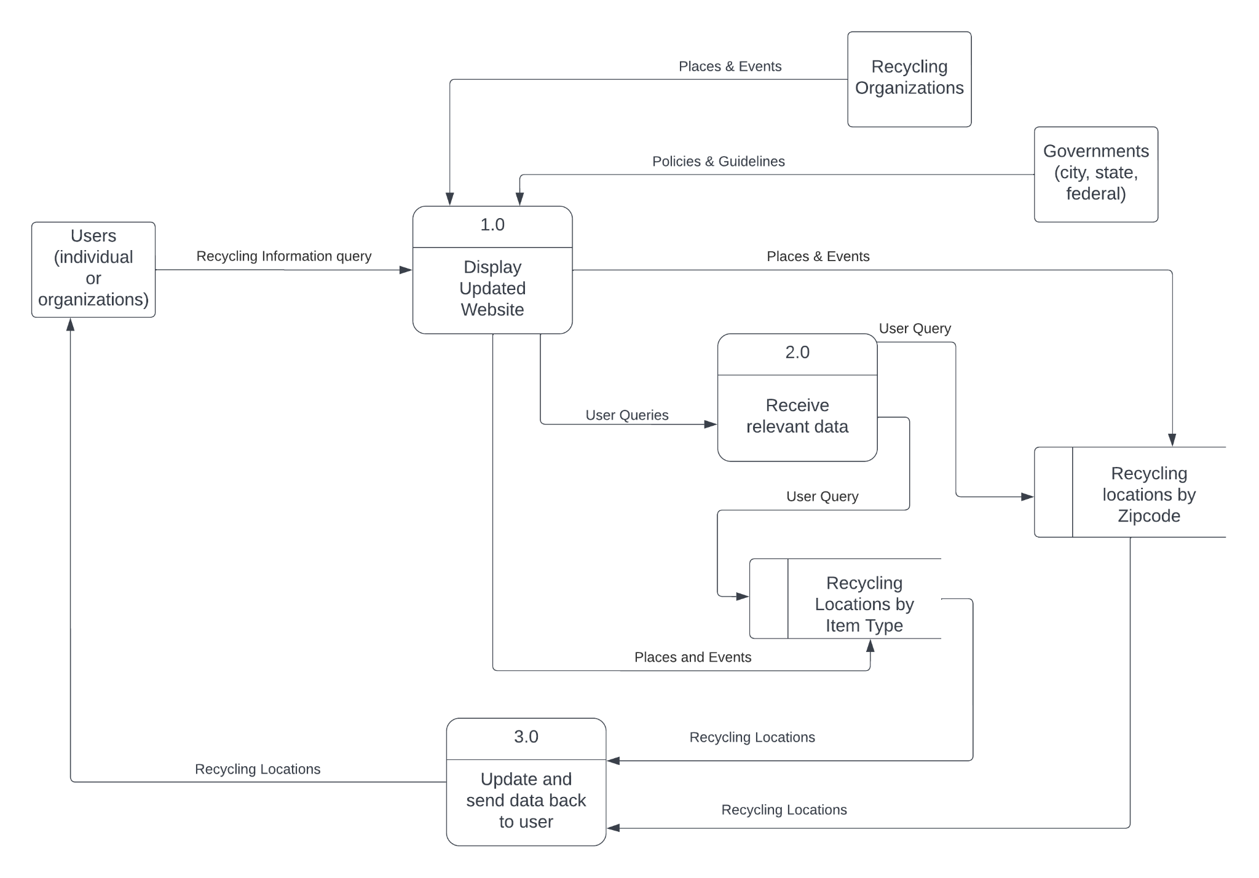
DFD Diagram (cont.)

Slide 9
Demo
Figma demo following…
Notes:
unifying vision for the service, how the service is embedded in the environment where it is used, and the features and functions of the service (data, process, interface, etc.)

Slide 10
Thanks!

